Slide 1
Transitions

Slide 2
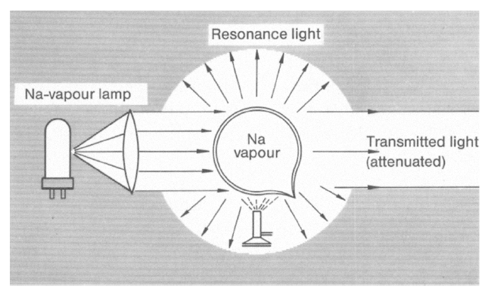
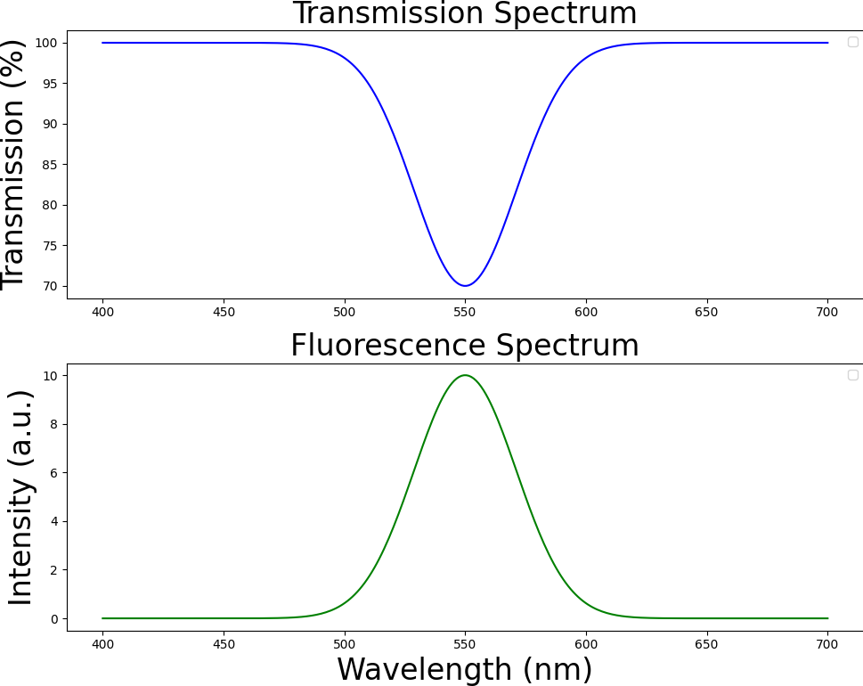



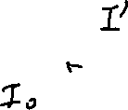




Transmission(absorption) and fluorescence spectrum
Tunable monochromatic incident light
Fluorescence
Incident light
Transmitted light

Slide 3
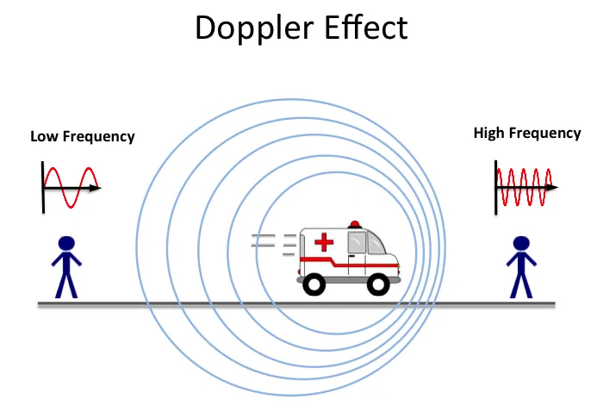
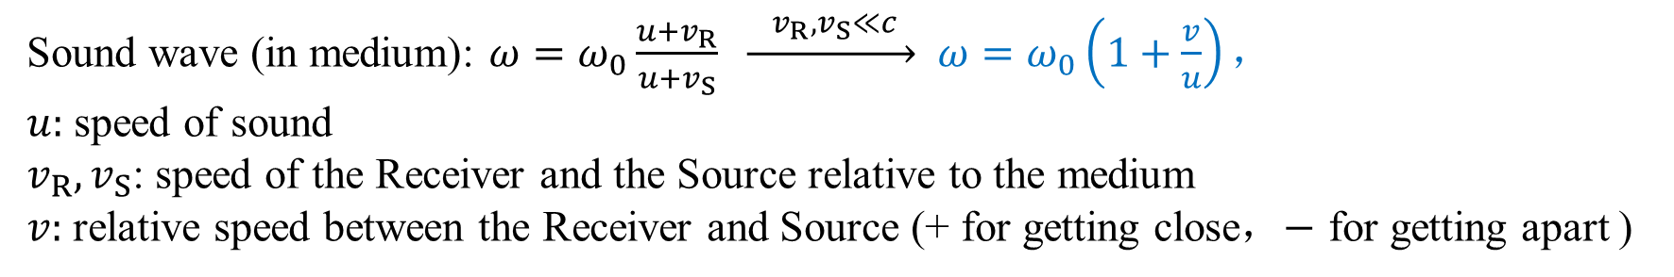
S
R
R
Sound wave (in medium): $ω=ω_{0}\frac{u+v_{R}}{u+v_{S}} \underset{→}{ v_{R},v_{S}≪c } ω=ω_{0}\left(1+\frac{v}{u}\right)，$
$u:$ speed of sound
$v_{R},v_{S}$: speed of the Receiver and the Source relative to the medium
$v:$ relative speed between the Receiver and Source (+ for getting close，$−$ for getting apart )

Slide 4
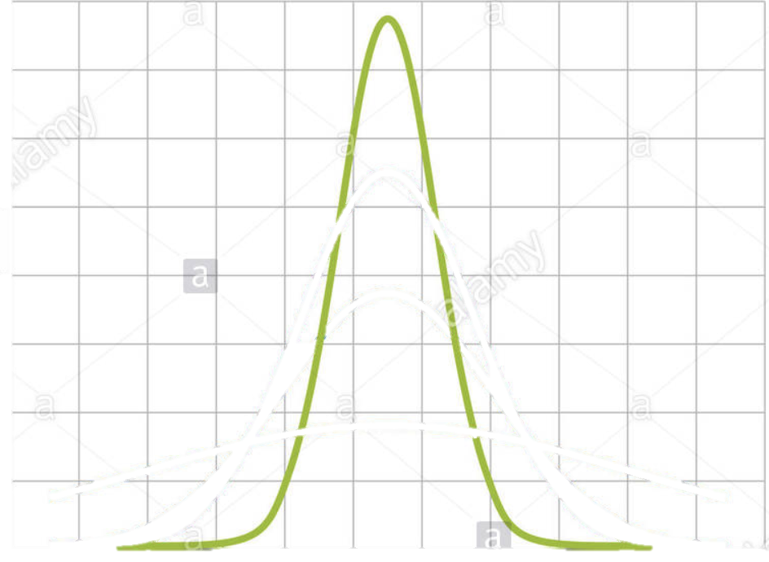
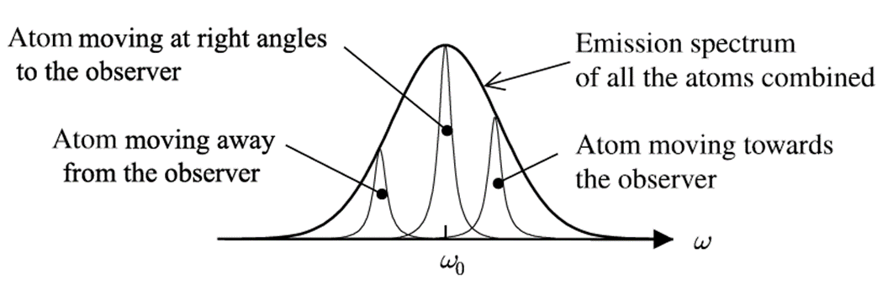

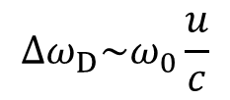
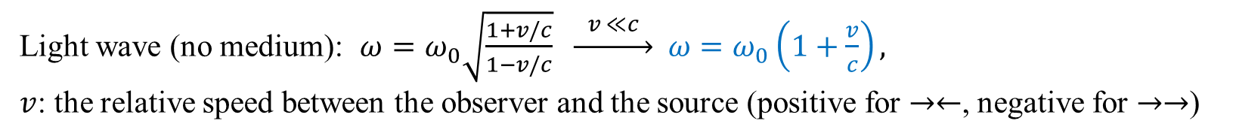

Doppler shift and Doppler broadening of spectrum
Light wave (no medium): $ω=ω_{0}\sqrt{\frac{1+v/c}{1−v/c}} \underset{→}{ v ≪c } ω=ω_{0}\left(1+\frac{v}{c}\right),$
$v$: the relative speed between the observer and the source (positive for $→←$, negative for $→→$)
$$0$$
$$v_{x}$$
$$Δω_{D}\sim ω_{0}\frac{u}{c}$$
The same transition in atoms of different velocities emit light of different frequencies. And the thermal velocity distribution of atoms causes the Doppler broadening of the spectrum. Doppler broadening is also called inhomogeneous broadening.

Slide 5

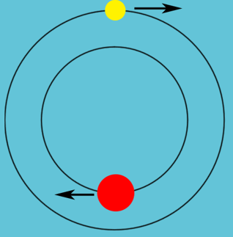
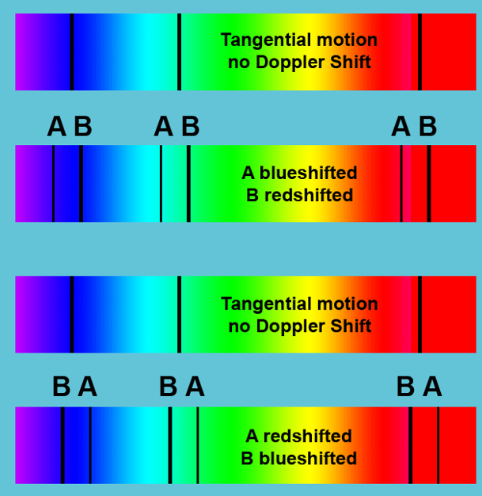

The spectrum of a double-star（Doppler effect）

Slide 6
How transition process
1917, using the Bohr model, Einstein re-derived the blackbody radiation.
He found three microscopic mechanisms of atomic transitions,
  spontaneous emission
  stimulated absorption
  stimulated emission
And the relation of their rates.

Slide 7
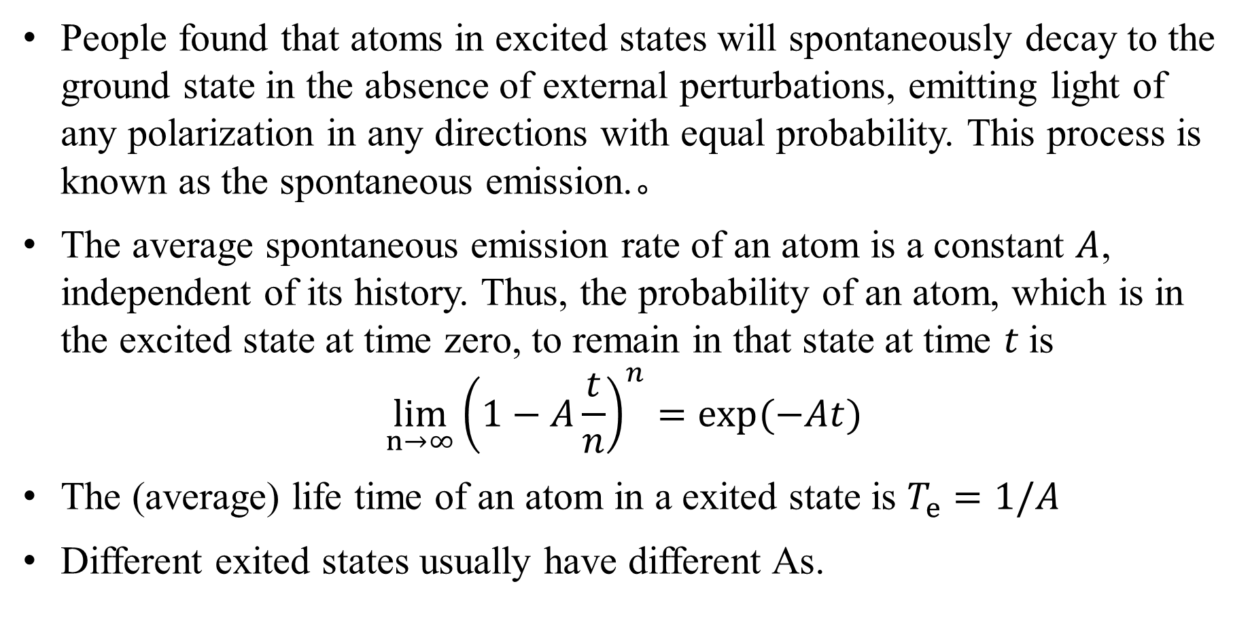
spontaneous emission
People found that atoms in excited states will spontaneously decay to the ground state in the absence of external perturbations, emitting light of any polarization in any directions with equal probability. This process is known as the spontaneous emission.。
The average spontaneous emission rate of an atom is a constant $A$, independent of its history. Thus, the probability of an atom, which is in the excited state at time zero, to remain in that state at time 𝑡 is
$$\lim_{n→∞}{{\left(1−A\frac{t}{n}\right)}^{n}}=\exp{(−At)}$$
The (average) life time of an atom in a exited state is $T_{e}=1/A$
Different exited states usually have different As.

Slide 8



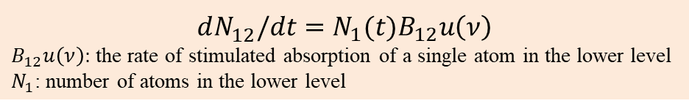
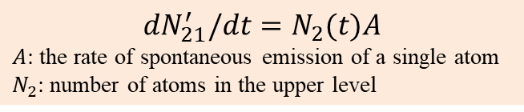
Einstein’s derivation of Planck’s formula
Every monochromatic radiation corresponds to two energy levels of the atoms on the cavity walls: $hν=E_{2}−E_{1}$.
Suppose there are two processes involved in the transition.
Rate of transitions
Spontaneous emission
Random direction & polarization
$$dN_{21}^{′}/dt=N_{2}(t)A$$
$A:$ the rate of spontaneous emission of a single atom
$N_{2}:$ number of atoms in the upper level
$$dN_{12}^{}/dt=N_{1}(t)B_{12}u\left(ν\right)$$
$B_{12}u\left(ν\right):$ the rate of stimulated absorption of a single atom in the lower level
$N_{1}$: number of atoms in the lower level
Stimulated absorption
Equilibrium
condition
equilibrium distribution
Since the A, B coefficients are solely related to the microscopic mechanisms of the atom and are independent of macroscopic statistical quantities such as temperature, this result cannot be manipulated to agree with the Planck formula.
Notes:
对于受激辐射（吸收），要假设其发生速率正比于光强或辐射场的能量密度。

Slide 9
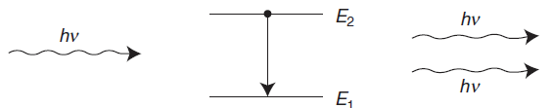

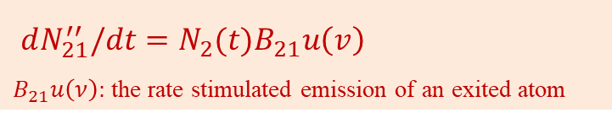

The third mechanism
Einstein hypothesized the third mechanism, Stimulated emission
Rate of transitions
Spontaneous emission
$$dN_{21}^{′}/dt=N_{2}(t)A$$
Stimulated absorption
$$dN_{12}^{}/dt=N_{1}(t)B_{12}u\left(ν\right)$$
Stimulated emission
$dN_{21}^{′′}/dt=N_{2}(t)B_{21}u\left(v\right)$
$B_{21}u\left(ν\right):$ the rate stimulated emission of an exited atom
An incident photon stimulates an atom in the exited state to emit a photon identical (direction, frequency, phase) to itself
Equilibrium
condition
Equilibrium distribution
Notes:
对于受激辐射（吸收），要假设其发生速率正比于光强或辐射场的能量密度。

Slide 10
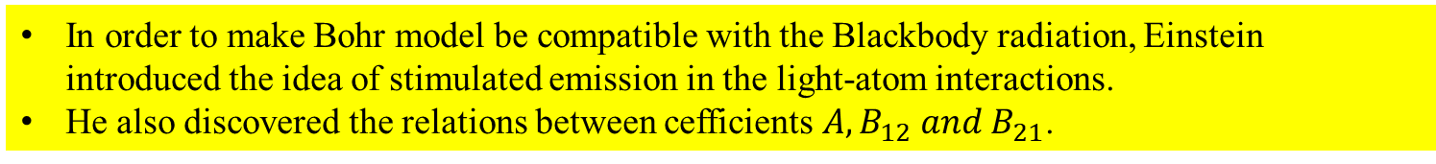

Einstein A, B coefficients and Blackbody radiation formula
Since A, B describe the interaction between single atom and photon, they should be independent of $T$
$u\left(ν\right)→∞$ if $T→∞$. Thus
In order to make Bohr model be compatible with the Blackbody radiation, Einstein introduced the idea of stimulated emission in the light-atom interactions.
He also discovered the relations between cefficients $A,B_{12} and B_{21}$.
Notes:
如果不考虑受激辐射，则将得到Wien公式

Slide 11



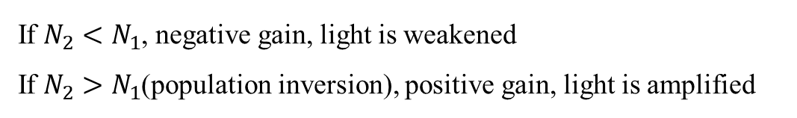
The principles of Lasers (light amplification by stimulated emission radiations)
$$dN_{21}^{′}/dt=AN_{2}(t)$$
spontaneous emission rate
$dN_{21}^{′′}/dt=Bu\left(v\right)N_{2}(t)$
stimulated emission rate
$$dN_{12}^{}/dt =Bu\left(ν\right)N_{1}(t)$$
stimulated absorption rate
Because the spontaneously emitted photons go in all directions, they have negligible contribution to the number of photons in the same mode as the incident radiation. The net gain of photons in the same mode is
If $N_{2}<N_{1}$, negative gain, light is weakened
If $N_{2}>N_{1}$(population inversion), positive gain, light is amplified

Slide 12
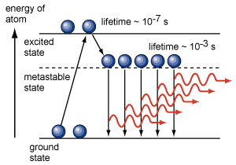
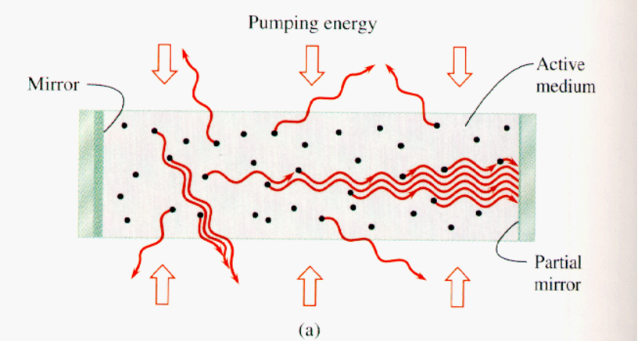
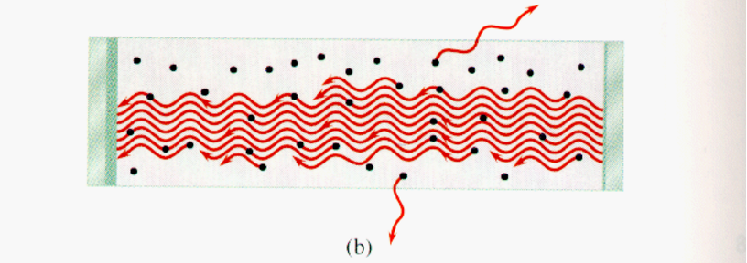
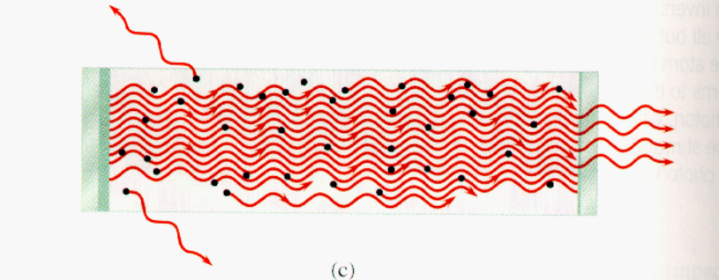
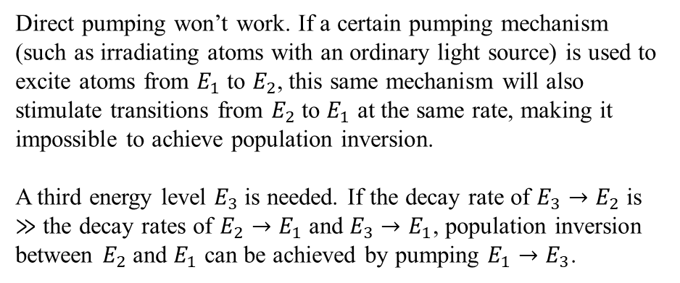
How to make a Laser
1. pumping population inversion
2. Resonant cavity
E3
E2
pumping
E1
Direct pumping won’t work. If a certain pumping mechanism (such as irradiating atoms with an ordinary light source) is used to excite atoms from $E_{1}$ to $E_{2}$, this same mechanism will also stimulate transitions from $E_{2}$ to $E_{1}$ at the same rate, making it impossible to achieve population inversion.
A third energy level $E_{3}$ is needed. If the decay rate of $E_{3}→E_{2}$ is $≫$ the decay rates of $E_{2}→E_{1}$ and $E_{3}→E_{1}$, population inversion between $E_{2}$ and $E_{1}$ can be achieved by pumping $E_{1}→E_{3}$.
Only radiations$⊥$ the mirrors can be amplified repeatedly
Notes:
● E3到E2的跃迁速率要远远大于E2到E1的跃迁速率
● 如果采用某种机制直接抽运原子E1到E2, 则这些抽运机制也会激励原子从E2向E1跃迁, 这样的跃迁即使产生辐射, 但出来的光子除了频率外, 其他性质也是互相独立的, 无法全同.
● 在谐振腔内, 增益介质最初只发出各向同性的自发跃迁, 但是总有可能某个光子的飞行方向正好和镜子垂直, 那么它就可以原路返回, 由它激发出来的光子和它一模一样, 它们再两个镜面之间来回反射, 队伍不断扩大, 形成激光.
●增益曲线代表可以被介质放大的光的波长范围，腔模分布代表可以在谐振腔内形成驻波的光波的波长。如果腔摸间隔较大，使得增益曲线线宽内，只有一个模会被显著放大，则形成单模激光。

Slide 13
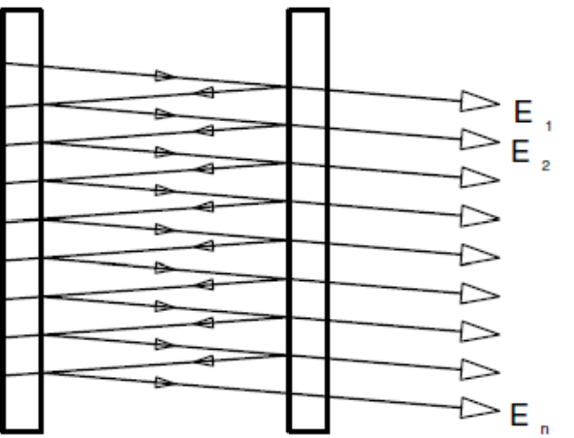
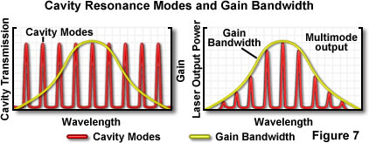
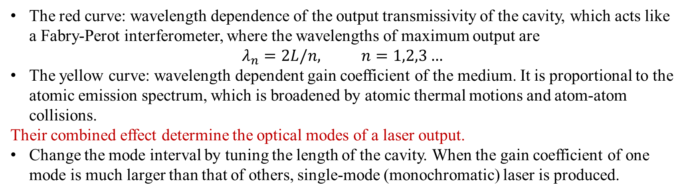
How to make a laser
3. Cavity mode selection
Fabry-Perot Interferometer
The red curve: wavelength dependence of the output transmissivity of the cavity, which acts like a Fabry-Perot interferometer, where the wavelengths of maximum output are
$$λ_{n}=2L/n, n=1,2,3…$$
The yellow curve: wavelength dependent gain coefficient of the medium. It is proportional to the atomic emission spectrum, which is broadened by atomic thermal motions and atom-atom collisions.
Their combined effect determine the optical modes of a laser output.
  Change the mode interval by tuning the length of the cavity. When the gain coefficient of one mode is much larger than that of others, single-mode (monochromatic) laser is produced.

Slide 14
*Stimulated and spontaneous emission rate
$$=mode density×average photon number per mode×single photon energy$$
$$\frac{stimulated emission rate}{spontaneous emission rate}=the average photon number currently in the radiation$$
This result is obtained from the radiation field in thermal equilibrium. However, since A, B coefficients are parameters describing a single atom, it is valid for general cases.
Notes:
受激辐射是否可以改成受激吸收，进而推导出基尔霍夫定律

Slide 15
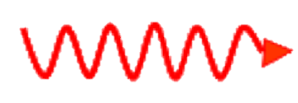



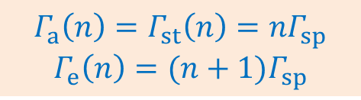





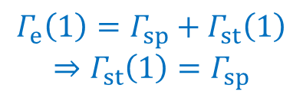








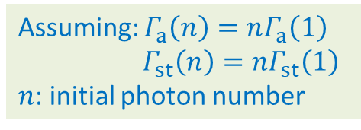





*Relation between the absorption and emission rates
Time-reversal symmetry of E&M:
forward and backward events have equal rates
$$E_{2}$$
$$E_{2}$$
$$Γ_{sp}$$
$$Γ_{a}(1)$$
$$Γ_{a}\left(1\right)=Γ_{sp}$$
$$E_{1}$$
$$E_{1}$$
Assuming: $Γ_{a}\left(n\right)=nΓ_{a}\left(1\right)$
$Γ_{st}\left(n\right)=nΓ_{st}\left(1\right)$
$n$: initial photon number
$$Γ_{e}(1)$$
$$E_{2}$$
$$E_{2}$$
$$Γ_{a}(2)$$
$$Γ_{e}\left(1\right)=Γ_{a}\left(2\right)=2Γ_{a}\left(1\right)=2Γ_{sp}$$
$$E_{1}$$
$$E_{1}$$
$$Γ_{sp}$$
$$Γ_{st}(1)$$
$$E_{2}$$
$$E_{2}$$
$$Γ_{e}\left(1\right)=Γ_{sp}+Γ_{st}\left(1\right)$$
$$⇒Γ_{st}\left(1\right)=Γ_{sp}$$
$$E_{1}$$
$$E_{1}$$
$$Γ_{a}\left(n\right)=Γ_{st}\left(n\right)=nΓ_{sp}$$
$$Γ_{e}\left(n\right)=(n+1)Γ_{sp}$$

Slide 16
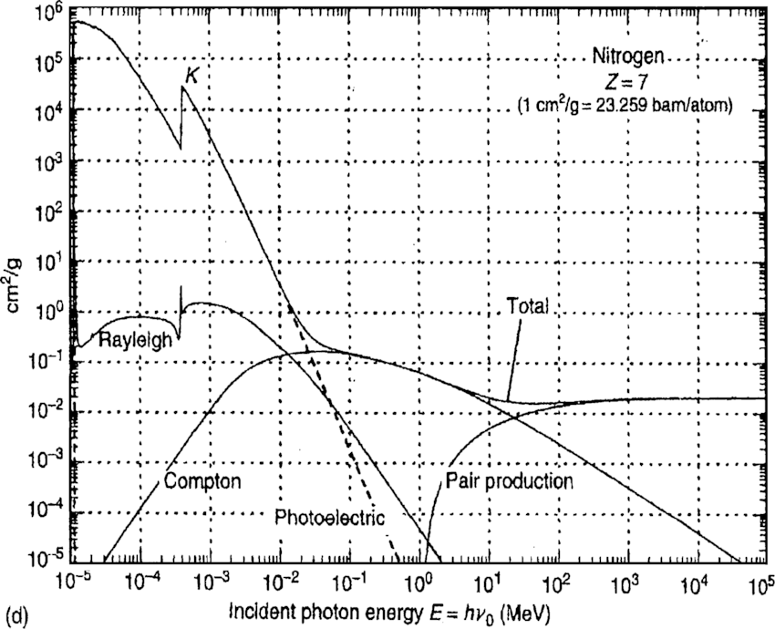

$$barn=10^{−28}m^{2}$$
The interaction cross section between N atoms and photons of different energies

